Slide 1


SENTENCE STRUCTURE
Writing Support Desk
writingsupport@uwindsor.ca

Slide 2
EVERY SENTENCE NEEDS
A SUBJECT &
PREDICATE

Slide 3
SENTENCE
subject
predicate

Slide 4
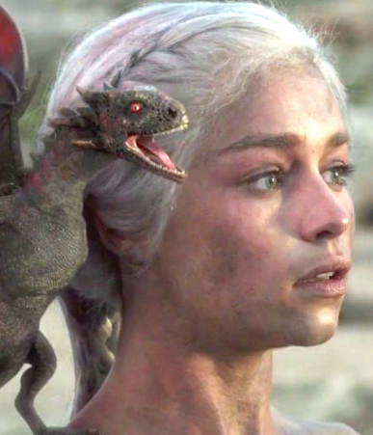
SUBJECT
The subject is the person, place, or thing that the sentence is about.
To find the subject, simply look for the verb and determine who or what is performing the verb.
ex. THE PRINCESS→
4

Slide 5
SUBJECT
simple subject
subject modifier

Slide 6
SIMPLE SUBJECT
The simple subject is the noun/pronoun or nouns/pronouns attached to the verb.
___________ trained her dragon.
THE PRINCESS →
SHE →
DAENERYS →
6

Slide 7
SUBJECT MODIFIER
The part of the subject that describes the simple subject.
This may include adjectives and/or prepositional phrases.
It is not present in all sentences.
7

Slide 8
SUBJECT MODIFIER
The powerful
princess of the
Targaryen dynasty
trained her dragon.
8

Slide 9
SUBJECT MODIFIER
The powerful
princess of the
Targaryen dynasty
trained her dragon.
WHAT IS THE VERB?
9

Slide 10
SUBJECT MODIFIER
The powerful
princess of the
Targaryen dynasty
trained her dragon.
VERB
10

Slide 11
SUBJECT MODIFIER
WHO IS DOING THE VERB?
The powerful
princess of the
Targaryen dynasty
trained her dragon.
11

Slide 12
SUBJECT MODIFIER
The powerful
princess of the
Targaryen dynasty
trained her dragon.
SIMPLE SUBJECT
12

Slide 13
SUBJECT MODIFIER
DO ANY WORDS/PHRASES DESCRIBE THE SIMPLE SUBJECT?
The powerful
princess of the
Targaryen dynasty
trained her dragon.
13

Slide 14
SUBJECT MODIFIER
The powerful
princess of the
Targaryen dynasty
trained her dragon.
ADJECTIVE
14

Slide 15
SUBJECT MODIFIER
The powerful
princess of the
Targaryen dynasty
trained her dragon.
PREPOSITION
15

Slide 16
SUBJECT MODIFIER
The powerful
princess of the
Targaryen dynasty
trained her dragon.
PREPOSITIONAL PHRASE
16

Slide 17
SUBJECT MODIFIER
The powerful
princess of the
Targaryen dynasty
trained her dragon.
PUT IT ALL TOGETHER!
17

Slide 18
SUBJECT MODIFIER
The powerful
princess of the
Targaryen dynasty
trained her dragon.
SUBJECT
18

Slide 19

PREDICATE
The predicate contains a verb, and provides information about the subject.
THE PRINCESS TRAINED. →
5
19

Slide 20
PREDICATE
simple predicate
object
subject complement

Slide 21
PREDICATE
A simple predicate is just the verb.
An object is a noun/pronoun or nouns/pronouns that the subject is acting upon/doing the verb to.
5
21

Slide 22
SIMPLE PREDICATE
The powerful
princess of the
Targaryen dynasty
trained.
VERB
22
10

Slide 23
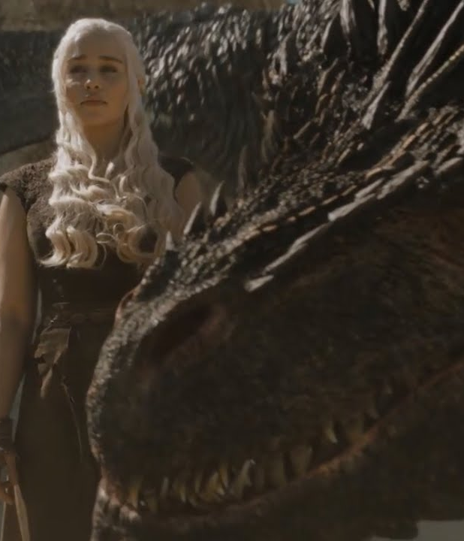
SIMPLE PREDICATE
The powerful
princess of the
Targaryen dynasty
Trained her dragon.
TRAINED WHAT?
10
23

Slide 24
OBJECT
The powerful
princess of the
Targaryen dynasty
trained her dragon.
OBJECT
VERB
10
24

Slide 25
SUBJECT COMPLEMENT
A subject complement provides information about the subject.
It usually follows a linking verb (is, seems, appears, sounds, feels, looks, etc.).
5
25

Slide 26
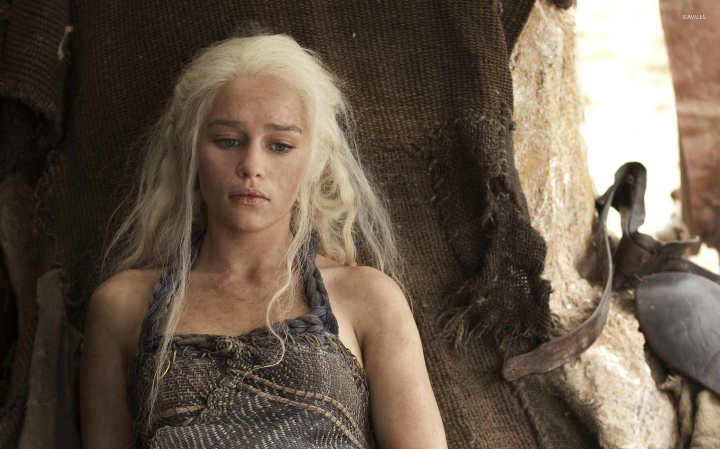
SUBJECT COMPLEMENT
The powerful
princess of the
Targaryen dynasty
is exhausted.
VERB
SUBJECT COMPLEMENT
10
26

Slide 27
SUBJECT COMPLEMENT
The powerful
princess of the
Targaryen dynasty
felt tired.
VERB
SUBJECT COMPLEMENT
27

Slide 28
subject
simple subject
subject modifiers
predicate
simple predicate
object
subject complement
SENTENCE

Slide 29


Slide 30
CONJUNCTIONS
MAKE CONNECTIONS

Slide 31
CONJUNCTIONS
coordinating
subordinating

Slide 32
COORDINATING CONJUNCTIONS
INDEPENDENT CLAUSES each have a subject and a predicate. They can form full sentences on their own.
Give equal weight to ideas.
Are used to form compound sentences by combining independent clauses.
Are introduced with a comma.
32

Slide 33
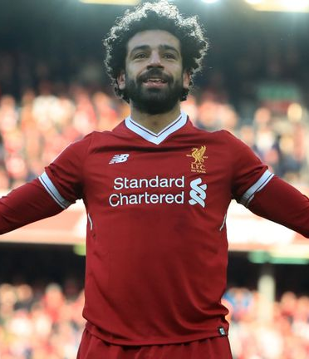
INDEPENDENT CLAUSES
Salah scored his 50th goal for his team.
The audience chanted his name.
33

Slide 34
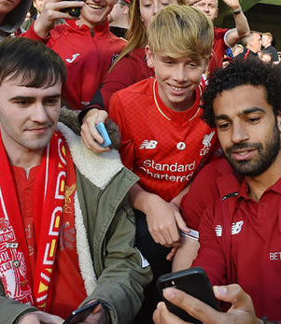
COORDINATING CONJUNCTIONS
F: For (explains why)
A: And (addition)
N: Nor (excludes)
B: But (disagree/contrast)
O: Or (alternative)
Y: Yet (disagree/contrast)
S: So (consequence)
34

Slide 35
SENTENCE MATH
INDEPENDENT CLAUSE
+ comma & coordinating conjunction
+ INDEPENDENT CLAUSE
= COMPOUND SENTENCE
Salah scored his 50th goal for his team
, so
the audience chanted his name.
= COMPOUND SENTENCE

Slide 36
COMPOUND SENTENCE
Salah scored his 50th
goal for his team , so
the audience
chanted his name.
COORDINATING CONJUNCTION
36

Slide 37
COMPOUND SENTENCE
Salah scored his 50th
goal for his team , and
he celebrated.
COORDINATING CONJUNCTION
37

Slide 38
COMPOUND SENTENCE
Salah scored his 50th
goal for his team , but
he is aiming for 100.
COORDINATING CONJUNCTION
38

Slide 39
SUBORDINATING CONJUNCTIONS
A SUBORDINATE CLAUSE cannot stand alone as a sentence and must be accompanied by an independent clause.
Give more weight to one idea.
Are used to form complex sentences by combining independent and subordinate clauses.
39

Slide 40
SUBORDINATING CONJUNCTIONS
after although as because before even if even though if in order that | once provided that rather than since so that than that though unless | until when whenever where whereas wherever whether while why

Slide 41
SENTENCE MATH
INDEPENDENT CLAUSE
+ subordinating conjunction
+ SUBORDINATE CLAUSE
= COMPLEX SENTENCE
Salah plays in England
although
he is from Egypt.
= COMPLEX SENTENCE
Subordinating conjunction
+ SUBORDINATE CLAUSE
+ comma & INDEPENDENT CLAUSE
= COMPLEX SENTENCE
Although
he is from Egypt,
Salah plays in England.
= COMPLEX SENTENCE

Slide 43
types of SENTENCES
simple sentence
compound sentence
complex sentence
complex-compound sentence

Slide 44
simple sentence
simple or compound subject
simple or compound predicate
Simple sentences consist of ONE independent clause and do not use coordinating or subordinating conjunctions.

Slide 45
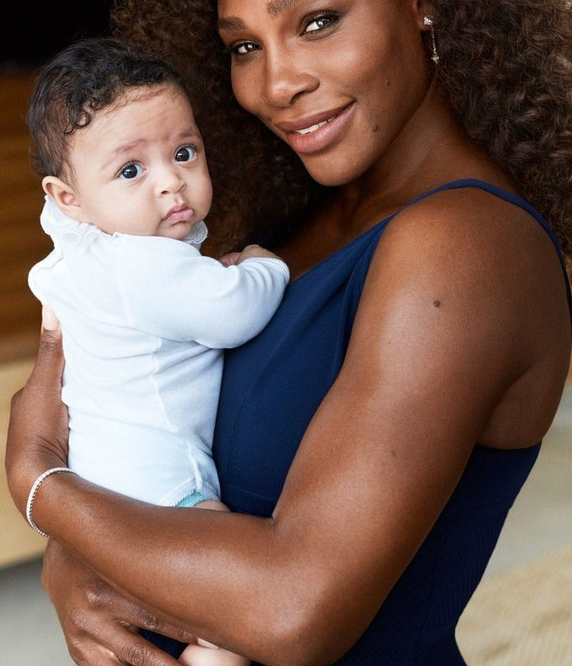
SIMPLE SUBJECT & SIMPLE PREDICATE
Serena Williams
gave birth to a
baby girl.
SIMPLE SUBJECT
SIMPLE PREDICATE
45

Slide 46
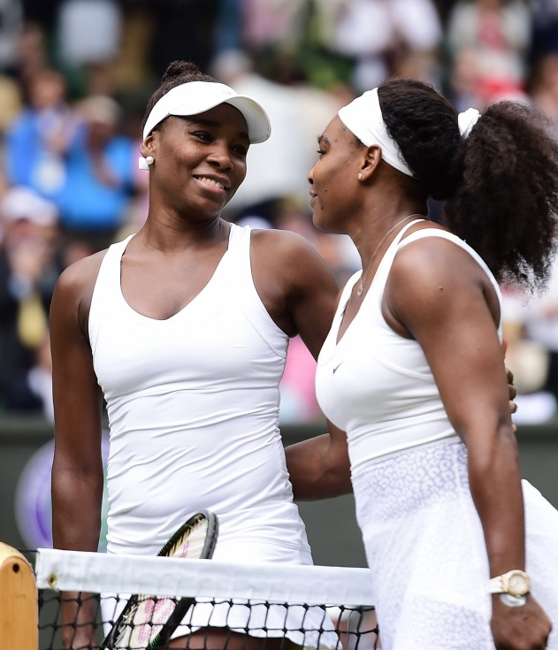
COMPOUND SUBJECT & SIMPLE PREDICATE
Venus and Serena Williams
play tennis.
COMPOUND SUBJECT
SIMPLE PREDICATE
46

Slide 47
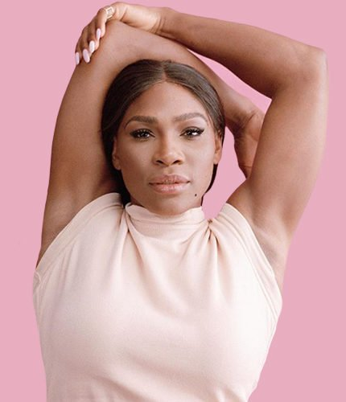
SIMPLE SUBJECT & COMPOUND PREDICATE
Serena Williams
plays tennis and
designs clothes.
SIMPLE SUBJECT
COMPOUND PREDICATE
47

Slide 48
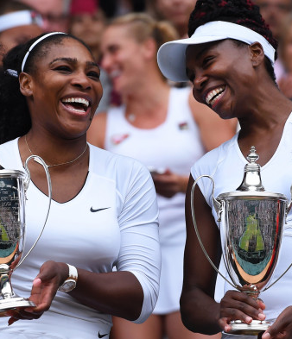
COMPOUND SUBJECT & COMPOUND PREDICATE
Venus and Serena Williams
won the French Open and the Australian Open.
COMPOUND SUBJECT
COMPOUND PREDICATE
48

Slide 49
REMEMBER
Compound sentences contain two independent clauses.
These clauses are joined with a coordinating conjunction or a semicolon.
49

Slide 50
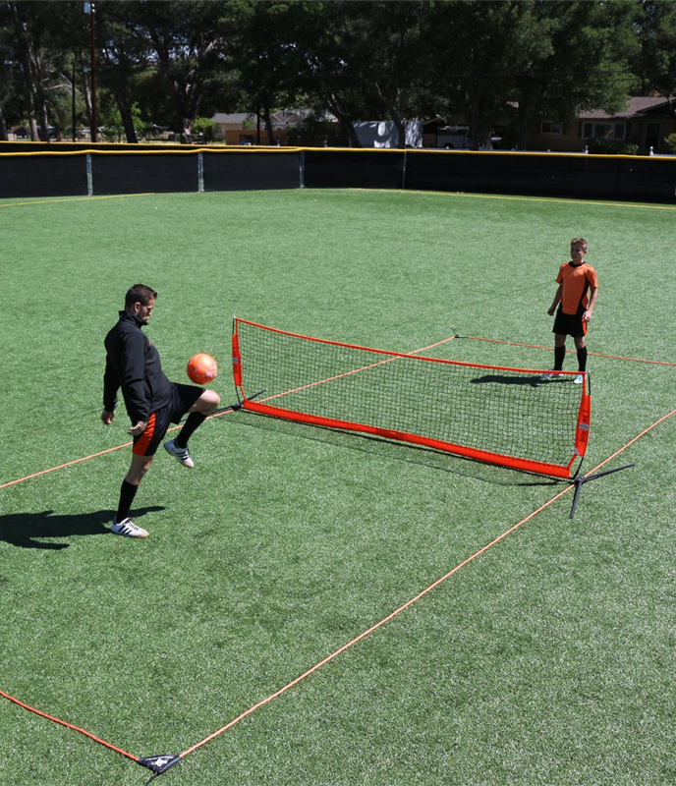
COMPOUND SENTENCE
Lee prefers to watch soccer
,but
Amir thinks tennis is a more interesting sport.
50

Slide 51
COMPOUND SENTENCE
INDEPENDENT CLAUSE #1
Lee prefers to watch soccer
,but
Amir thinks tennis is a more interesting sport.
51

Slide 52
COMPOUND SENTENCE
INDEPENDENT CLAUSE #1
Lee prefers to watch soccer
,but
Amir thinks tennis is a more interesting sport.
INDEPENDENT CLAUSE #2
52

Slide 53
COMPOUND SENTENCE
INDEPENDENT CLAUSE #1
Lee prefers to watch soccer
COORDINATING CONJUNCTION
,but
Amir thinks tennis is a more interesting sport.
INDEPENDENT CLAUSE #2
53

Slide 54
REMEMBER
Complex sentences contain an independent clause and a subordinate clause.
These clauses are joined with a subordinating conjunction.
54

Slide 55
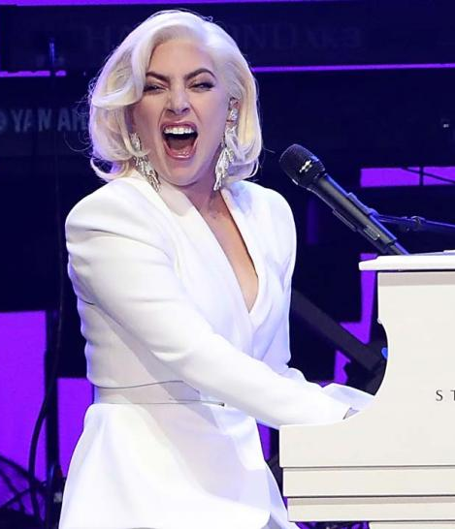
COMPLEX SENTENCE
Lady Gaga is my favourite singer
because
she writes her own songs.
55

Slide 56
COMPLEX SENTENCE
INDEPENDENT CLAUSE
Lady Gaga is my favourite singer
because
she writes her own songs.
56

Slide 57
COMPLEX SENTENCE
INDEPENDENT CLAUSE
Lady Gaga is my favourite singer
SUBORDINATING CONJUNCTION
because
she writes her own songs.
57

Slide 58
COMPLEX SENTENCE
INDEPENDENT CLAUSE
Lady Gaga is my favourite singer
SUBORDINATING CONJUNCTION
because
she writes her own songs.
SUBORDINATE CLAUSE
58

Slide 59
COMPLEX SENTENCE
SUBORDINATING CONJUNCTION
Because she writes her own songs,
COMMA
SUBORDINATE CLAUSE
Lady Gaga is my favourite singer.
INDEPENDENT CLAUSE
59

Slide 60
COMPLEX-COMPOUND
sentences do exactly what their name suggests:
they combine
COMPLEX and COMPOUND sentences!
60

Slide 61

COMPLEX SENTENCE
Although the flights were expensive,,
SUBORDINATE CLAUSE
she flew to China.
INDEPENDENT CLAUSE
61

Slide 62
COMPLEX SENTENCE
SUBORDINATING CONJUNCTION
Although the flights were expensive,,
SUBORDINATE CLAUSE
she flew to China.
INDEPENDENT CLAUSE
62

Slide 63
COMPLEX-COMPOUND SENTENCE
Although the flights were expensive,,
SUBORDINATE CLAUSE
she flew to China,
and
2 INDEPENDENT CLAUSES
she visited her sister.
63

Slide 64
COMPLEX-COMPOUND SENTENCE
SUBORDINATING CONJUNCTION
Although the flights were expensive,,
COORDINATING CONJUNCTION
SUBORDINATE CLAUSE
she flew to China,
and
2 INDEPENDENT CLAUSES
she visited her sister.
64

Slide 65
COMPLEX-COMPOUND SENTENCE
COMPLEX SENTENCE
Although the flights were expensive,
she flew to China,
and she visited her sister.
COMPOUND SENTENCE
65

Slide 67
QUESTIONS?
Remember, this slideshow and many others are available to download via the Writing Support Brightspace page.
Students can self-enroll as 'learners' either by selecting 'Discover' from the Brightspace landing page and clicking 'Enroll' on the Writing Support organization.

Slide 68
REFERENCES
General information on parts of a sentence: https://arts.uottawa.ca/writingcentre/en/hypergrammar/the-parts-of-the-sentence
General info on conjunctions: http://blog.writeathome.com/index.php/2013/07/50-subordinating-conjunctions-and-why-they-matter/
General info on sentence structure: https://en.wikipedia.org/wiki/Sentence_clause_structure
Kahoot image: https://bmhsscience.wordpress.com/2015/11/05/kahoot-website-web-based-quiz-generating-site/
Lady Gaga image: https://www.stubhub.co.uk/magazine/sites/default/files/styles/default_teaser/public/2018-01/lady-gaga-facts-uk-tour.jpg?h=df3c6bf4&itok=hRJJk7S6
Tennis soccer image: https://cdn.shopify.com/s/files/1/0097/7152/products/SoccerTennisCourt-_SQ.jpg?v=1478893166
Venus and Serena with trophies image: https://media.glamour.com/photos/578173736352b6be3fcbfa3e/master/w_1600,c_limit/GettyImages-545701976.jpg
Venus and Serena image: https://d3i6fh83elv35t.cloudfront.net/newshour/app/uploads/2015/09/GettyImages-479716260-1024x786.jpg
Serena Williams clothing line image: https://www.peacefuldumpling.com/wp-content/uploads/2018/08/Serena-Williams-700x500.jpg
Serena Williams and baby image: https://peopledotcom.files.wordpress.com/2018/01/serenawilliamsvogue1.png
Salah and fans image: https://media.gettyimages.com/photos/mohamed-salah-of-liverpool-with-fans-at-the-end-of-the-pre-season-picture-id826710596
Salah image: https://e1.365dm.com/18/03/768x432/skysports-mo-salah-mohamed_4261251.jpg?20180321173132
Daenarys with shoulder dragon image: https://static.independent.co.uk/s3fs-public/thumbnails/image/2015/05/13/10/daenerys-dragon-GameofThrones-2.jpg?w968h681
Tired Daenarys image: https://i.pinimg.com/736x/53/f6/04/53f604fbcbad5ae86b51c89d00d71080--daenerys-drogo-game-of-throne-daenerys.jpg
Daenarys with staff image: https://hips.hearstapps.com/digitalspyuk.cdnds.net/17/33/1502793788-emilia-clarke-daenerys-got.jpg?resize=480:*
Daenarys with large dragon image: https://i.ytimg.com/vi/24e_JTp0UEs/maxresdefault.jpg
Women in sunglasses and pen and paper image via Unsplash.com

